Slide 1

TriNetra
Team Members: 1. MatThew Schenk
2. Anusha Karnati
3. Sai Kishan Naraparaju

Slide 2
outline
Introduction / Overview
User’s Work Context
Use Cases
System Design
Demonstration
Test Report Results
Requirement Deviations
Deployment Issues
Developmental Process
Project Organization
Schedule Maintained
More Development Time
Remake
Learning Experience

Slide 3
Presenting: tasklogger by trinetra
Android Application developed for Tablets
Mimics a Personal Task Notebook
Fulfills functionality for quickly jotting down, searching, and deleting tasks

Slide 4
Why was it developed?
Currently the User documents their tasks in a small notebook.
Enable User to keep record of tasks in an e-format accessible on a tablet
This application will to store these tasks and information associated with them.
Quick search for specific tasks by entering any of the task information allows quick access to the user.
It allows the user to search for a task entry of a certain type, timespan, or information regarding the task and displays the results.

Slide 5
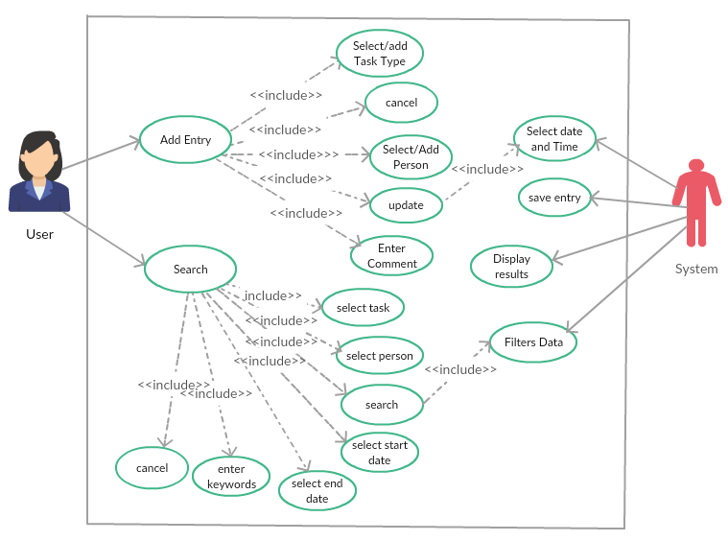
Use Case Diagram

Slide 6
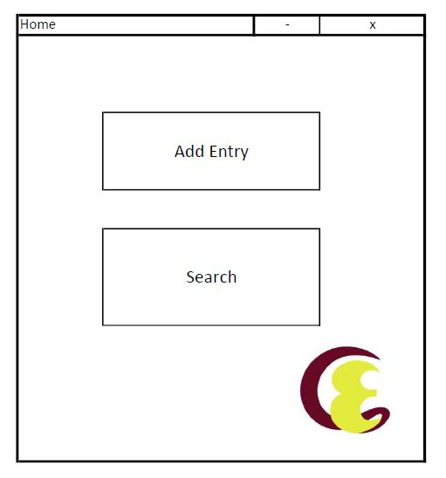
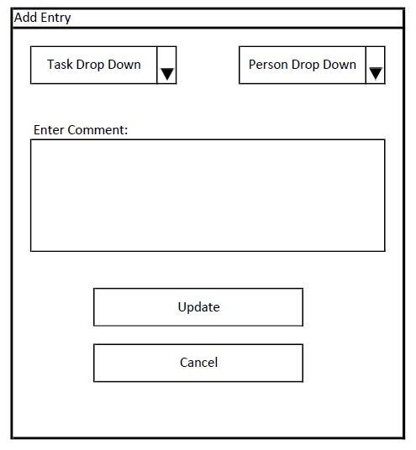
User Interface

Slide 7
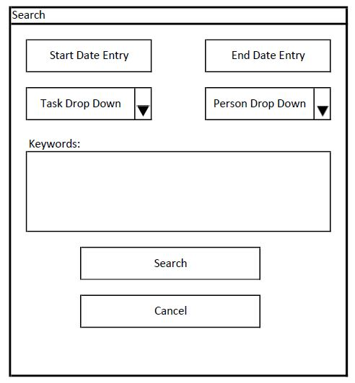
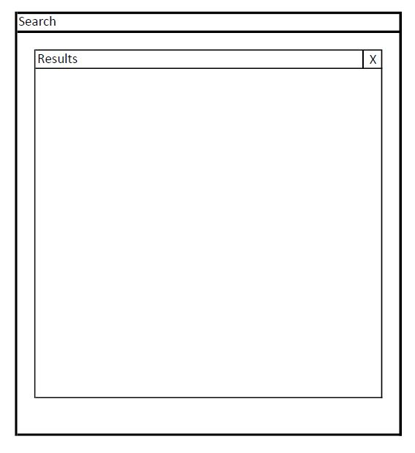
User Interface

Slide 8
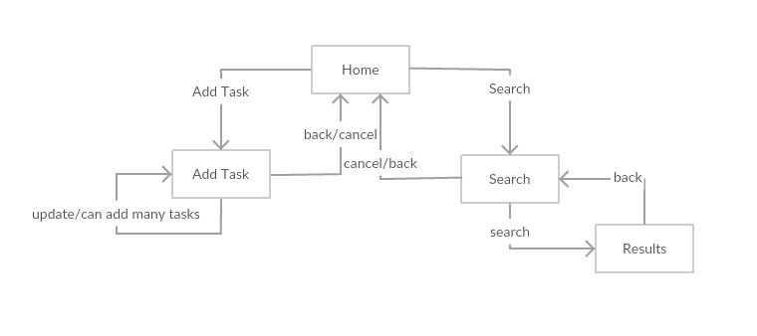
State transition Diagram

Slide 9


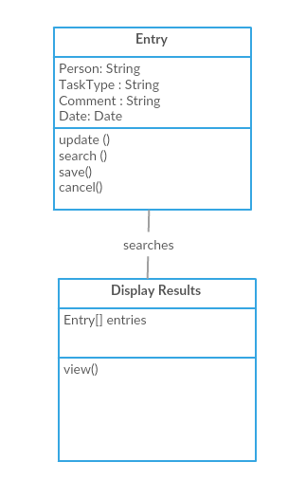
Class Diagram

Slide 10
demonstration

Slide 11
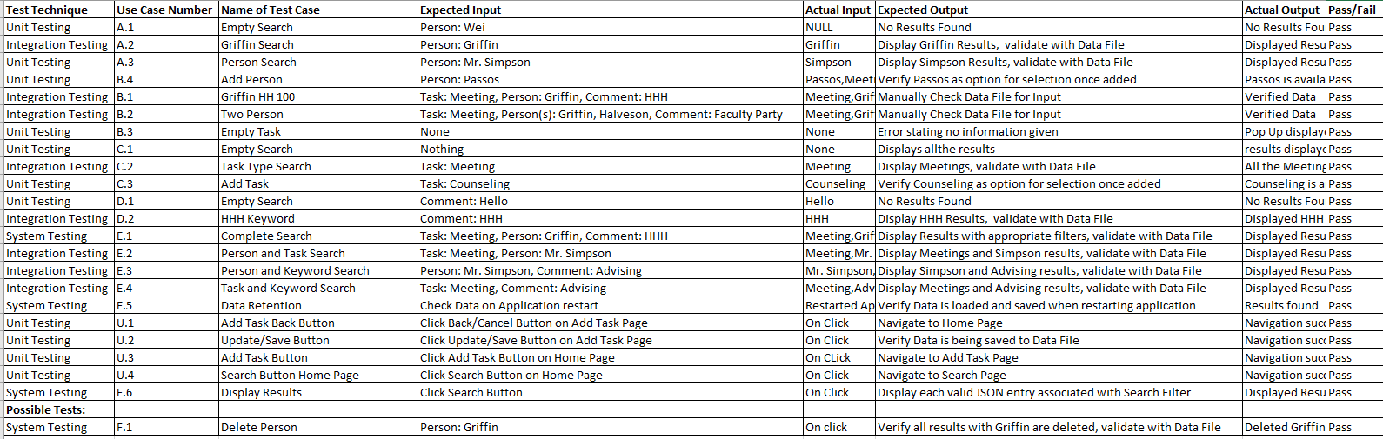
Test report results

Slide 12
Requirement deviations: Navigation

Slide 13
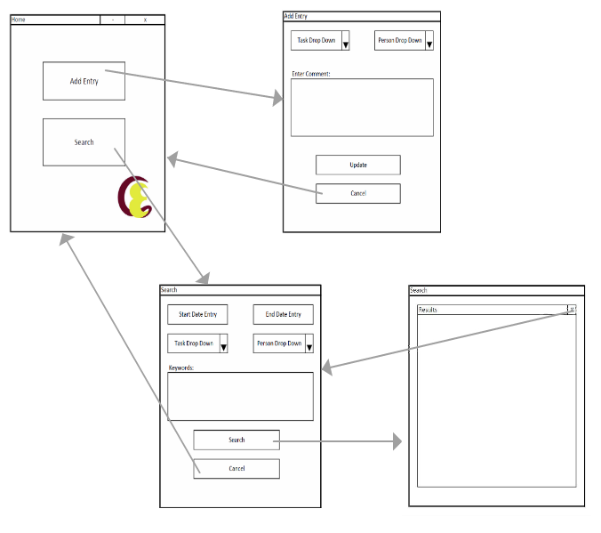
Original Navigation Diagram
Incomplete?
What does Update Do?
Why back to Home?
Tab Version Feedback

Slide 14
Could have Features implemented
This application must allow the user to add a task and search for a task.
Add Task allows to select a person, or multiple persons or organizations to be associated with the task, then able to select the type of the task and enter a comment associated with it.
This information along with the current time and date will be captured and stored to the device.
Since this is a stand-alone application, the information will be stored on the device’s local storage. This helps ensure security.
Utilizing the space, a feature to delete by date will most likely be important as years of tasks start to accumulate and should be added.

Slide 15
Deployment issues
Time on Tablet Issues: Six Hours Ahead
Time Displays: 10:1 should read 10:01
Stylus Button

Slide 16
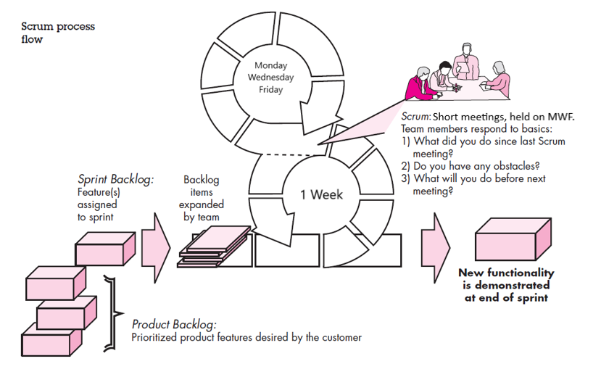
Development process: Scrum Method

Slide 17


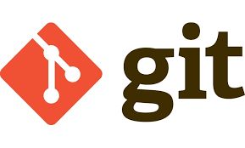
Project organization
Democratic Decentralized Structure
Scrum was a good fit
Quick, to the point, meetings after most classes on MWF
Able to appoint required tasks, and receive completed tasks within sprint window
Communication Channels worked well
GitHub was utilized as the project proved to large to attach in email

Slide 18
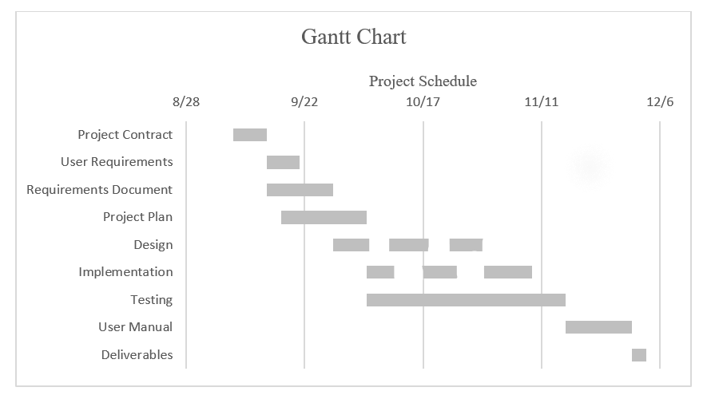
Original schedule Timeline

Slide 19
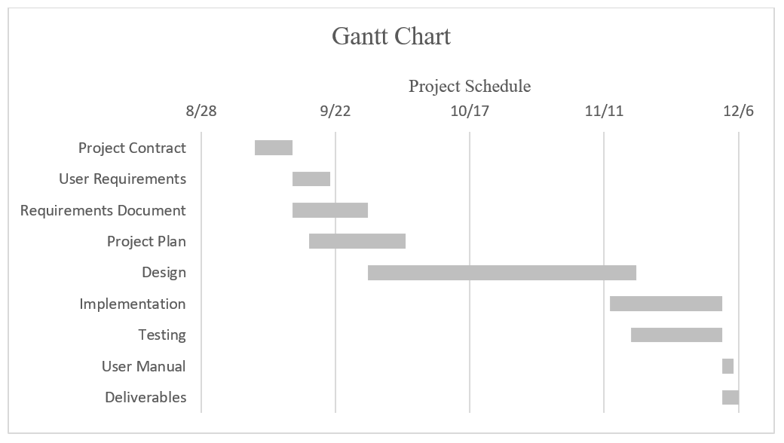
Accurate schedule Timeline

Slide 20
Schedule: October and Implementation Pushbacks
Data Design Decisions
Mid Term Tests
Other Projects Precedence
Personal Research Papers and Presentations

Slide 21
More Development time
Much Greater Testing Time Period
Scalable User Interface
Navigation Functionality
Multi Person Search
Sort Drop Downs

Slide 22
Complete remake
Edit Button on Results Page, Not a User Requirement or Feature but thought of
Data Recovery Method, possibly associated with google or apple account
No Server still, as that ruins the Personal Database Experience
Earlier Implementation
Much Greater Testing Time Period

Slide 23
Learning experience
Difficulty and Importance of Planning and Scheduling
Importance of Design Diagrams
Delegating tasks was more difficult than anticipated
Trust in Teammates, Team Interaction Environment
Greater Understanding of Ionic Framework, Cordova Plug-Ins, HTML, CSS, JavaScript
Improving our Technical Writing Skills
Experiencing Theoretical Concepts Applied to Industry Project

Slide 24
Thank you!

